Slide 1
Part I: Salinity Assessment & Prediction Software
(ESAP: with multiple application examples)
Part II: GIS Applications & Case Studies
Scott M. Lesch¹ & Dennis L. Corwin²
1. Principal Statistician, Dept. of Environmental Science, UCR
2. Research Soil Scientist, USDA-ARS US Salinity Laboratory
Arrowhead conference

Slide 2
Brief Overview of the ESAP Software Suite
ESAP Software Version 2.35
A series of integrated Windows based shareware software programs which can be used for the prediction of field scale, spatial soil salinity information (and/or other soil properties) from conductivity survey data.
ESAP has been specifically designed to facilitate cost-effective, technically sound, soil salinity assessment and data interpretation techniques.
ESAP can be down-loaded free of charge from the USDA-ARS US Salinity Laboratory website. A NRCS certified version (suitable for installing on NRCS desktop and laptop computers) is also available.
Arrowhead conference

Slide 3
ESAP Modeling Software (3 core programs)…
ESAP-RSSD
  examine, analyze, & summarize ECa survey data
  generating optimal soil sampling designs from sensor data
ESAP-SaltMapper
  1-D transect plots and 2-D raster maps
  tile line maps, calculate tile line locations, diagnose potential tile line problems
ESAP-Calibrate
  convert survey data into predicted soil salinity (a/o other soil properties)
  diagnose & identify primary soil properties influencing survey data
  generate multiple field summary statistics
  generate prediction data (for making spatial maps)
Arrowhead conference

Slide 4
ESAP Support Software (2 support programs)…
ESAP-SigDPA
  performs signal data pre-processing chores, data QA/QC and validity checks, scale conversions, and row (transect) identification & assignment.
DPPC-Calculator
  a convenient to use calculator version of the 1989 Rhoades DPPC model.
  can be used for direct prediction of salinity from spot 4-probe or EM survey data, given additional soil temperature, texture, and moisture measurements (or estimates).
Arrowhead conference

Slide 5
ESAP is primarily designed for Statistical Calibration:
(i.e., Ordinary Regression Modeling)
A (spatially referenced) multiple linear regression model which typically includes both soil conductivity and trend surface parameters.
Typical EM38 model (for predicting Soil Salinity):
EC_{e} = b₀ + b₁(EM_{V}) + b₂(EM_{H}) + b₃(x) + b₄(y)
where EM_{V} and EM_{H} represent
the EM38 vertical and horizontal signal readings, and x and y
represent the spatial survey coordinates.
Arrowhead conference

Slide 6
Model based summary statistics & predictions:
Given our estimated regression model, we can calculate:
  the survey grid (field) mean, with an associated confidence interval
  the percentage of survey sites exceeding specific thresholds (for example, % area of field with salinity levels between 2 and 4 dS/m)
  individual (spatially referenced) soil property predictions, which in turn can be used to generate spatial maps
Arrowhead conference

Slide 7
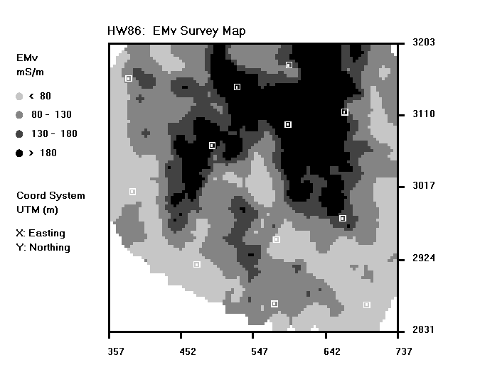
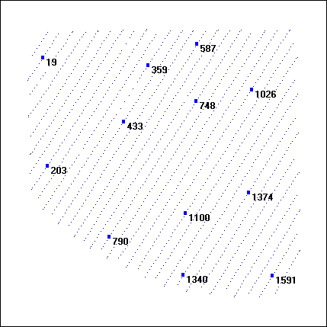
Example 1: dense grid of EC_{a} (EM38) survey data is imported into RSSD software and an optimized sampling plan is generated (EC_{e} soil samples will then be used to calibrate EM38 survey data).
Arrowhead conference

Slide 8
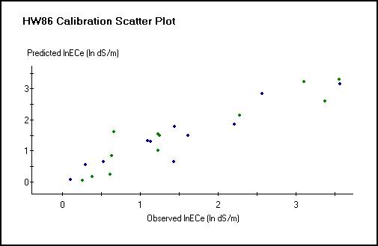
Regression model is then fit to calibration data and used to predict depth specific EC_{e} information from the EM signal data.
(for this example: R² = 0.91 & 0.89 for 0-2 & 2-4 ft depths)
Arrowhead conference

Slide 9
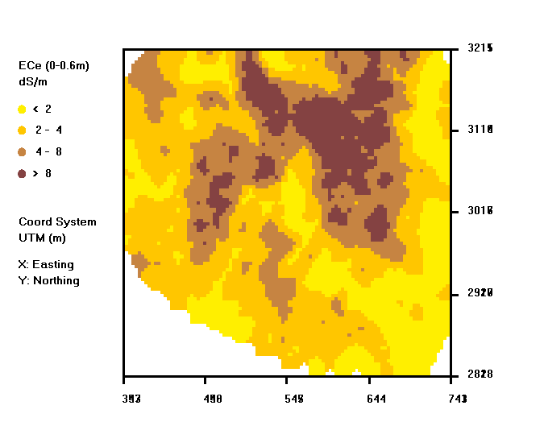
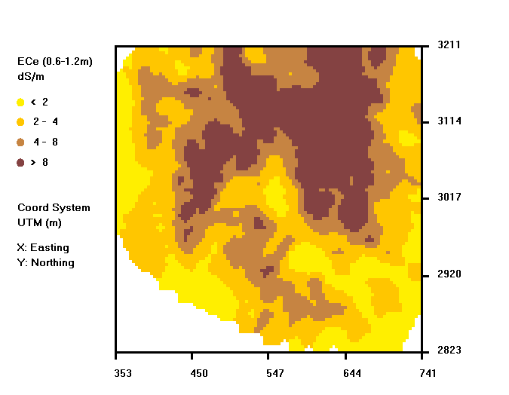
Final Product: predicted 0-2 ft & 2-4 ft Salinity Maps
Arrowhead conference

Slide 10
and predicted 0-2 ft & 2-4 ft summary statistics…
Geometric Mean Estimates (w/95% CI’s)
0-2 ft depth: 3.40 dS/m (2.66, 4.36)
2-4 ft depth: 4.39 dS/m (3.21, 6.04)
Range Interval Estimates (% area of field w/in specific range classes)
0-2 ft depth 2-4 ft depth
Range (dS/m) % %
< 2 28.3 22.5
2-4 31.2 25.9
4-8 23.8 24.0
> 8 16.7 27.6
Arrowhead conference

Slide 11
Additional ESAP-Calibrate software features
The prediction of additional soil physical / chemical properties is often possible (e.g., texture, water content, SAR, boron, etc.).
Steady-state leaching fraction maps can often be estimated (using salinity or chloride data).
If desired, estimates of Tons of Salt per acre/ft can be made (via TDS samples, composite cation-anion analysis, or estimated TDS=f(EC) relationship).
Can be used to test for changing spatial salinity conditions over time.
Can be used to estimate relative yield loss due to salinity for various crops, or calibrated directly to actual crop yield data (to produce absolute yield loss estimates and/or yield maps).
Arrowhead conference

Slide 12
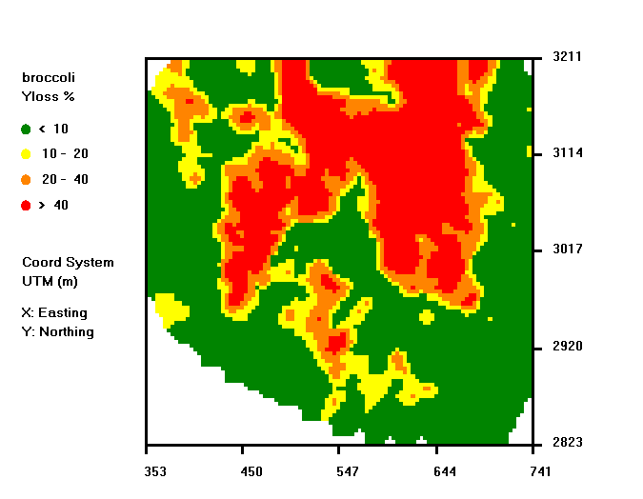
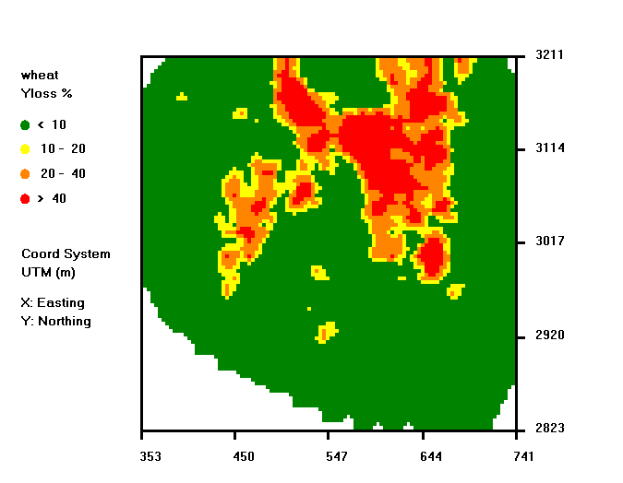
Example 2: Projected Yield Loss Maps
23.7% (broccoli) 10.4% (wheat)
Arrowhead conference

Slide 13
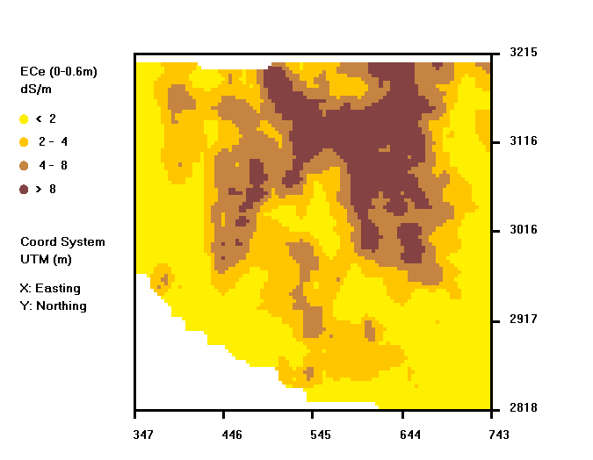
Example 3: Post-leaching 0-2 ft Salinity Map (and statistics)
Leaching Design: 20 E/W basins (18m x 380m) – basin spill-over design.
Apprx 45 ac-ft water (ECe = 1.1 dS/m) applied over 6 weeks (estimated evap loss = 11 ac-ft)
Post-leaching survey performed 4 weeks after final water application…
Geo-Mean Statistics:
Post: 2.91 dS/m Pre: 3.40 dS/m
(about a 17% reduction)
RIE Statistics:
Range Post Pre
0-2 38.6% 28.3%
2-4 25.3% 31.2%
4-8 19.6% 23.8%
> 8 16.5% 16.7%
Arrowhead conference

Slide 14
Pre- v.s. post-leaching 0-2 ft salinity maps…
Arrowhead conference

Slide 15
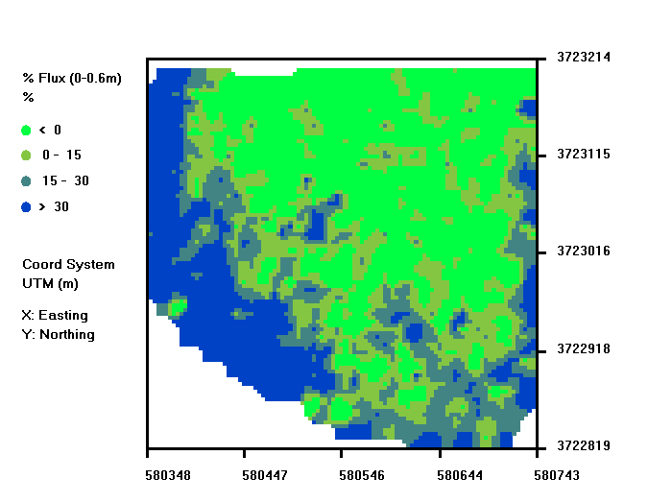
Example 3 (cont.): Calculated 0-2 ft Salt Displacement Map
Arrowhead conference

Slide 16
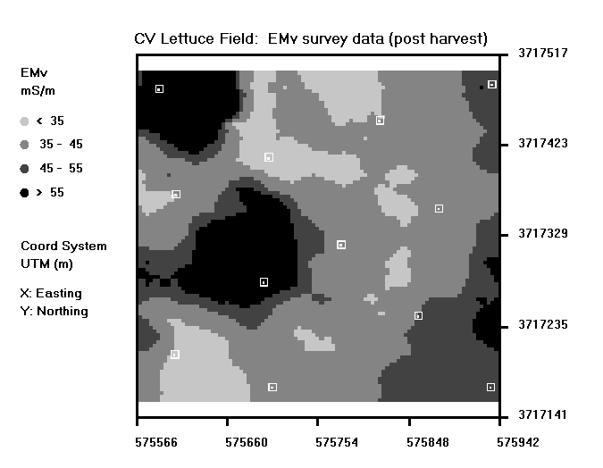
Mapping multiple soil properties
(Example 4: Soil salinity and % Clay content)
2003 survey of Coachella Valley lettuce field.
EC_{e} %Clay
(0-2 ft) (2-4 ft)
Mean 1.83 23.0
Std 0.99 7.5
Min 0.75 15.4
Max 3.69 42.5
Corr(lnEM, lnECe | 0-2 ft) = 0.78; Corr(lnEM, %Clay | 2-4 ft) = 0.83 for this field…
Arrowhead conference

Slide 17
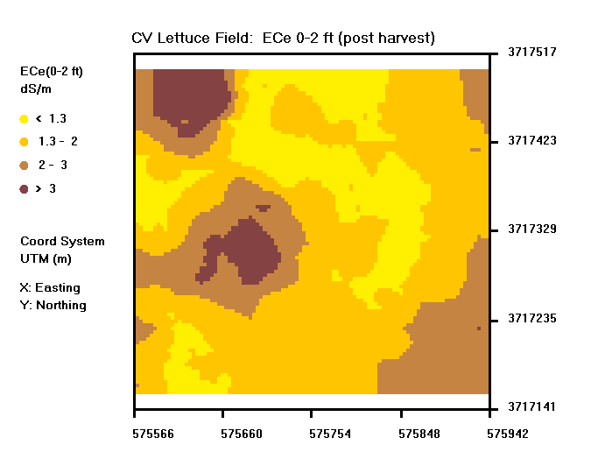
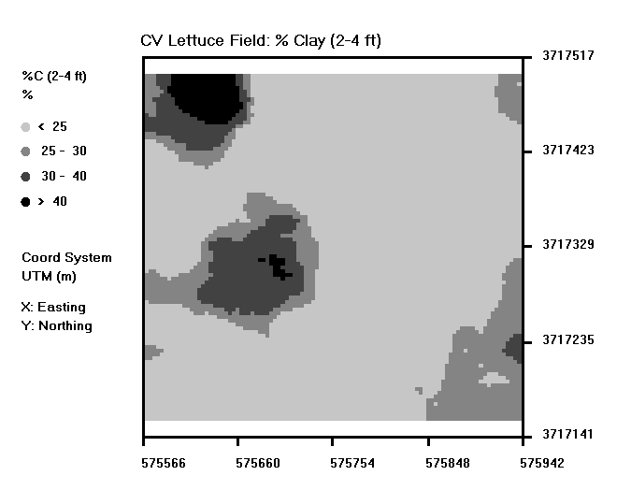
Deeper (2-4 ft) texture pattern appears to explain the corresponding 0-2 ft soil salinity map in this example...
Arrowhead conference

Slide 18
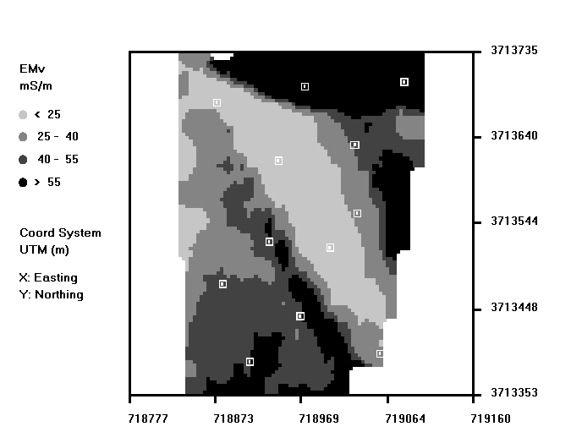
Mapping multiple soil properties
(Example 5: Soil salinity and Water content)
2001 survey of Palo Verde alfalfa field.
EC_{e} VH2o
Mean 1.34 0.17
Std 1.25 0.10
Min 0.23 0.03
Max 4.84 0.29
Corr(lnEM, lnECe) = 0.83; Corr(lnEM, VH2o) = 0.84 for this field…
Arrowhead conference

Slide 19
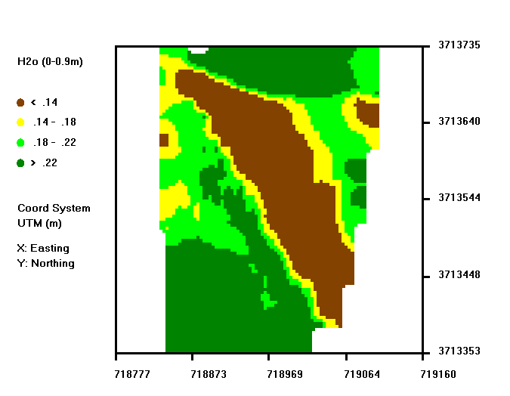
Corresponding bulk average (0-0.9 m) volumetric water content map…
Side note: this field was suffering from deficient irrigation scheduling; yield losses in alfalfa correspond to dry areas (below wilting point)…
Arrowhead conference

Slide 20
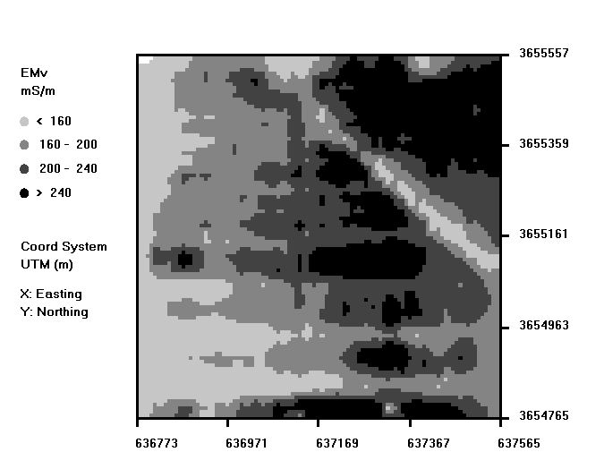
Example 6: Mapping tile line effects in an IID alfalfa field (using the ESAP SaltMapper program).
Arrowhead conference

Slide 21
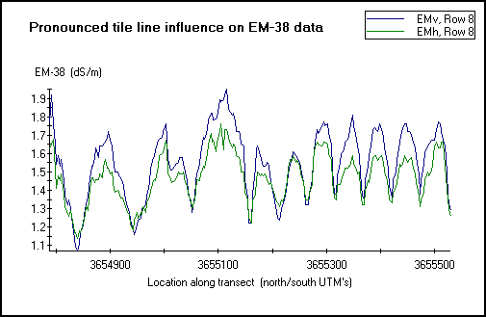
Observed tile line influence on spatial EM-38 signal levels across an Imperial alfalfa field.
Arrowhead conference

Slide 22
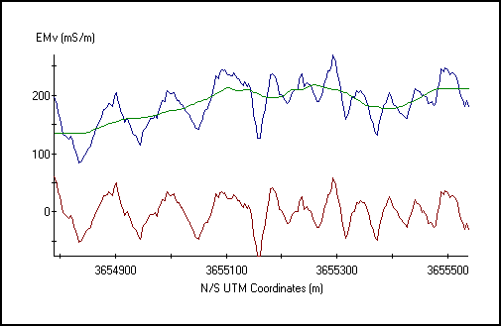
Example of “filtering” EMv transect data, in order to better identify underlying cyclic pattern (and identify positions of local minima)…
Arrowhead conference

Slide 23
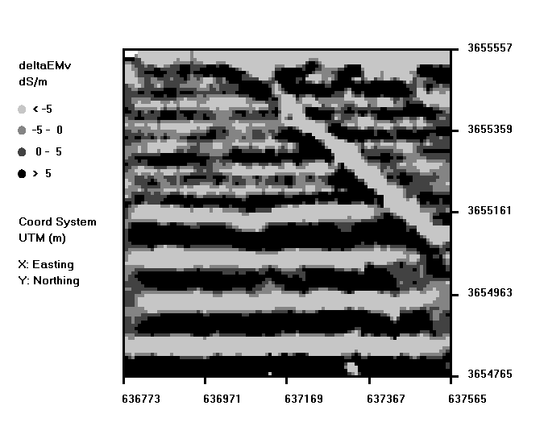
2D filtered EM signal data shows spatial tile line pattern and general tile line locations…
Arrowhead conference

Slide 24
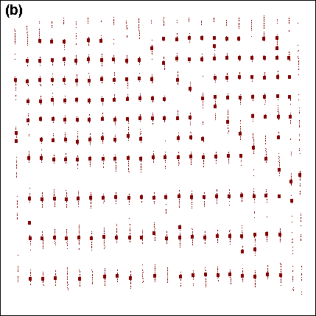
Accurate locations of each tile line can generally be determined by plotting the positions of the local minima within each survey transect.
Arrowhead conference

Slide 25
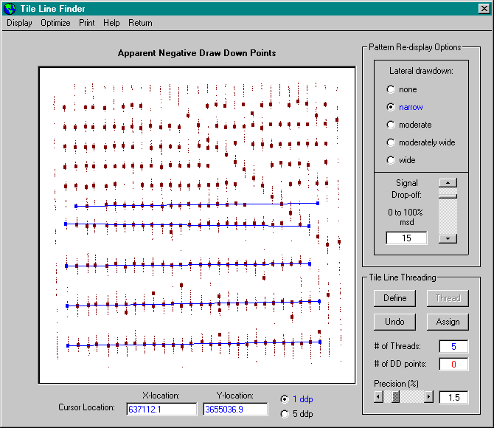
The user must first interactively identify the corresponding line positions (using the on-screen “threading” procedure)…
Arrowhead conference

Slide 26
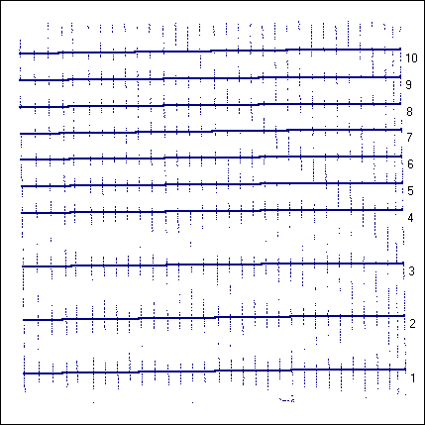
The exact physical locations of tile lines can then be identified and mapped using a built in ANOCOVA modeling procedure...
Using EM38 data from two separate surveys (performed 1 year apart), we were able to map the individual tile lines to within 1 m accuracy…
Arrowhead conference

Slide 27
End of Part I…
Arrowhead conference

